Slide 1
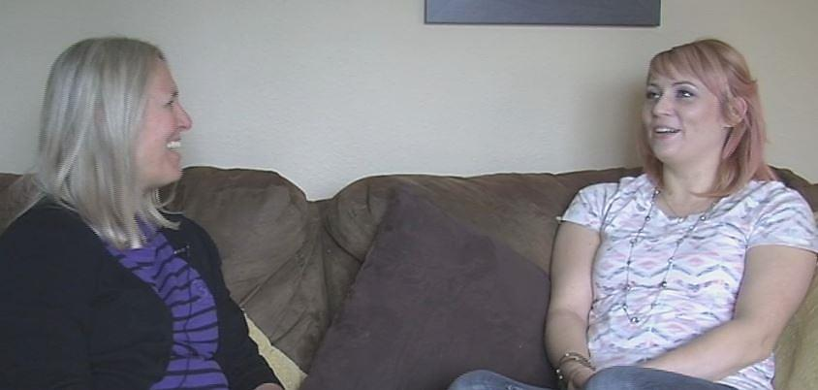
Guidance for Leading Focused Conversations with Families to Help Complete the DRDP (2015) For Home Visitors, Teachers, and other Service Providers
3/15/19

Slide 2
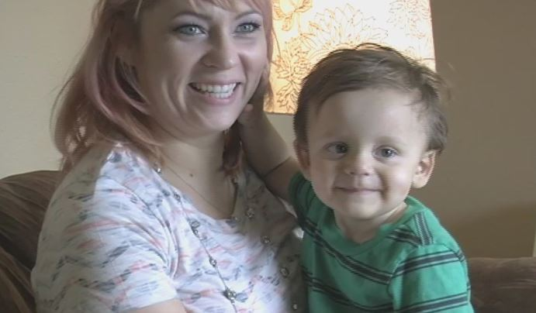
Focus of the Session
The purpose of this session is to help home visitors learn how to use a process that will help them confidently complete the DRDP (2015), even when they may not have had frequent opportunities to observe the child participating in a variety of routines and activities.

Slide 3
Materials
Guide to Leading Focused Conversations with Families to Help Complete the DRDP (2015)
Worksheet for Leading Focused Conversations with Families to Help Complete the DRDP (2015)

Slide 4
Leading Focused Conversations with Families
Ongoing conversations with family members are rich opportunities for learning about their child and should occur whenever we have contact with the family.
Additionally, it may be useful to lead conversations in a particularly focused manner during the two times a year when the DRDP (2015) is completed.
Having conversations with families is an important part of completing the DRDP (2015) for all assessors, but may be particularly important for home visitors who do not have frequent opportunities to observe the child participating in a variety of routines and activities.
When combined with your observations, the perspectives of families help you gain a more complete picture of a child across settings, activities, and when interacting with a variety of people.

Slide 5
Exercise: Getting from bed to work

Slide 6
4 Steps to Leading Focused Conversations
Step 1: Take an initial pass at completing the DRDP (2015) (using your current observations and documentation, rate the measures that you can and identify those for which you still need information)
Step 2: Identify child and family routines and activities
Step 3: Lead a focused conversation
Step 4: Take another pass at completing the DRDP (2015)

Slide 7
Focus on routines and activities
A key element of this process is focusing on the child and family’s everyday routines and activities.
Focusing on routines and activities provides a very useful context for asking a family about their child’s everyday learning opportunities and skills.

Slide 8
Be sure that the families are familiar with the DRDP (2015) right from the start
Points you might share with families:
The DRDP (2015) is an assessment based on ongoing observations of a child in typical, everyday routines and activities with familiar people.
There are many benefits to the DRDP (2015) – it provides service providers with up-to-date information that helps them plan learning activities and the information helps families know more about their child's development and ways that they can support their child's learning.
Having conversations with family members so they can share observations and information about their child is an important part of completing the DRDP (2015).

Slide 9
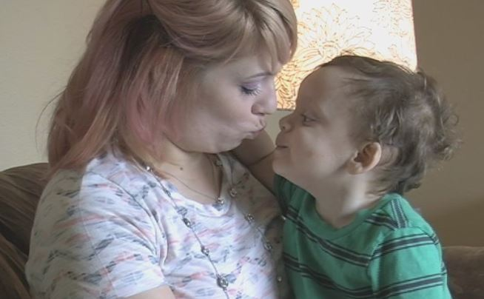
4-Step Process for Leading Conversations
Step 1: Take an initial pass at rating the measures
Step 2: Identify family routines and activities
Step 3: Lead a focused conversation
Step 4: Take another pass at rating the measures

Slide 10
Step 1: Take an initial pass at rating the measures
Gather together the materials that you will need
Take an initial pass at rating the measures

Slide 11
Gather together the materials that you will need
DRDP (2015) Assessment Manual;
Your documentation (this might include your observation notes, home visiting notes, portfolios, information from others, observations that you made to inform other authentic assessment tools, etc.);
Rating Record (Optional); and
Worksheet for Leading Focused Conversations with Families to Help Complete the DRDP (2015)

Slide 12
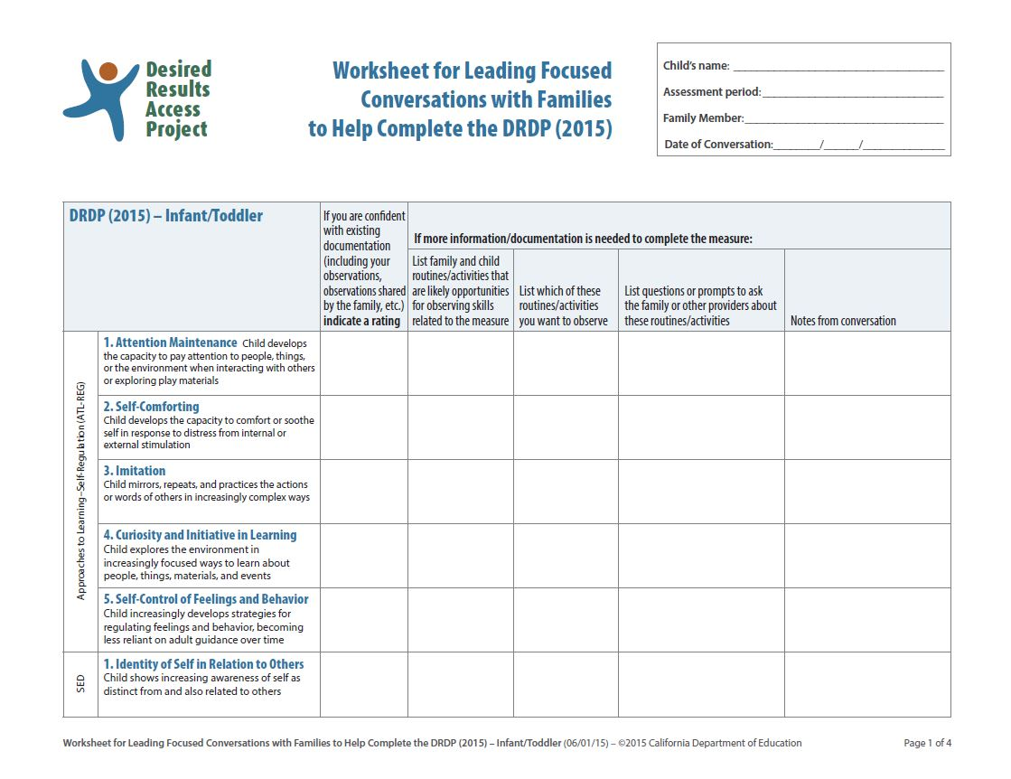
Worksheet for Leading Conversations with Families to Help Complete the DRDP (2015)

Slide 13
Using the assembled materials take an initial pass at rating the measures
Complete the measures you are confident you can rate based on the current information you have
Identify the measures that you need additional information to rate

Slide 14
Step 2: Identify family routines and activities
Think of routines or activities that the family participates in that would be likely opportunities for observing skills related to those measures in question.
List which of these routines/activities you want to arrange to observe.
Plan a focused conversation to have with the family. List some general questions you will use to ask the family about those routines or activities.

Slide 15
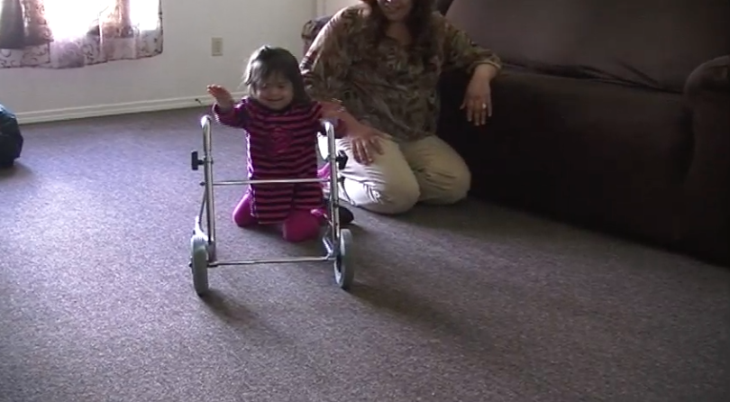
Meet Crystal

Slide 16
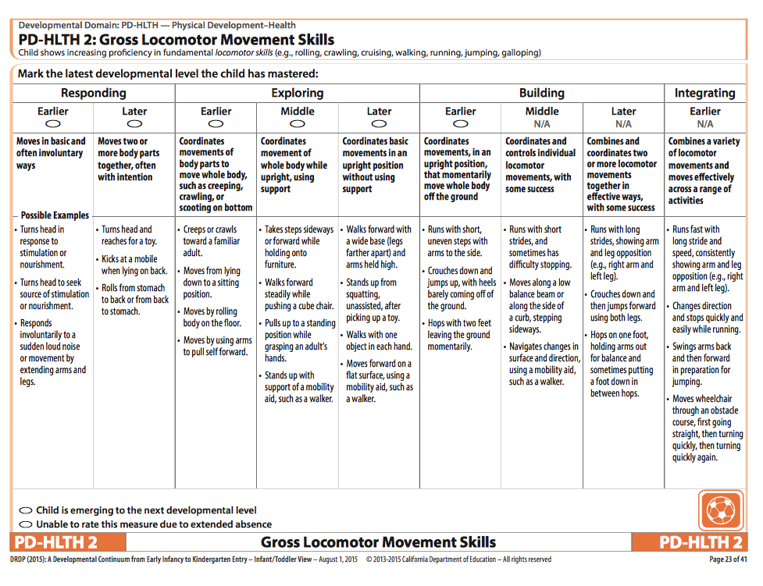

Slide 17
Let’s Watch Crystal!

Slide 18
Discussion Questions
What do we know and what don’t we know about Crystal’s skills related to PD-HLTH 2 from the information in the clip?
During what typical routines and activities might we see Crystal demonstrate the kinds of skills described in PD-HLTH 2?
What are some examples of open-ended questions that we might ask a parent to better understand Crystal’s gross movement skills during those activities?

Slide 19
Step 3: Lead a focused conversation
Remind the family about the things you’ve previously shared about the DRDP (2015).
Describe, in family-friendly language, the general domains or measures you want to focus on (avoid merely reading the exact wording of the measures).

Slide 20
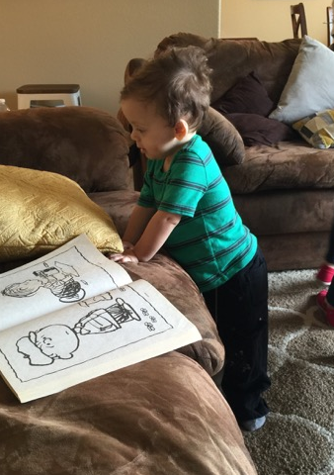
Examples of General Follow-up Questions
You said that he [does this], tell me more about what that looks like.
What changes have you observed in mealtime over the past month or so?
What parts of mealtime does he need help with?
What have you been doing to help him?
Does he use any special equipment or other things during mealtime? If so, what does he use?
How does he let you know what he wants and doesn’t want during mealtime?

Slide 21
More Focused Follow-up Questions
You might use more focused questions that will help you understand the child’s highest level of mastery on specific measures, e.g., “Tell me what he’s like when he plays with other children his age?”
You might use “wondering questions” to help identify the highest level of mastery. For example, you might ask a family member, “During our last visit, I saw Max pick up his toy phone. I was wondering, when he plays with the phone, what does he usually do with it?”
If you are able to narrow down your choices of the child’s highest level of mastery to two adjacent descriptors, then you might ask the family, “Does he do it more like [this] or [that]?” Reviewing the examples from the two adjacent descriptors may help you come up with wording for the “this” and “that.”

Slide 22
Remember, when asking questions
Avoid asking close-ended questions that ask the family to respond to exact wording of descriptors or examples

Slide 23
Step 4: Take another pass at rating the measures
As you complete the measures that were in question, also double-check the measures for which you assigned ratings previously.
Keep in mind that talking about routines and activities with families often leads them to share information about skills that not only appear in one measure but that might appear in other measures as well.

Slide 24
Conversation with Crystal’s mother

Slide 25
Ways to prepare to lead the process
Watch the video online
Read the handout and keep it handy as a reference
Download the worksheet: www.draccess.org/leadingconversations
Choose a child and family to start with whom you have been working with for a while and know well

Slide 26
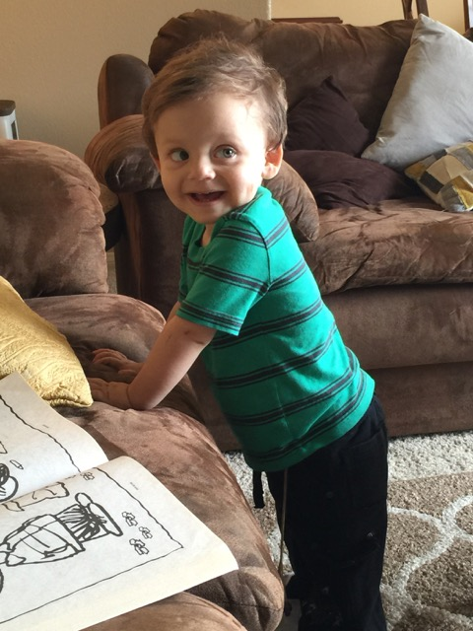
Wrap Up
Any questions?

